Slide 1
Gandhara Art BFA I Section: C, D
Class Teacher: Aasma Abdul Majeed
Visual Arts, LCWU

Slide 2
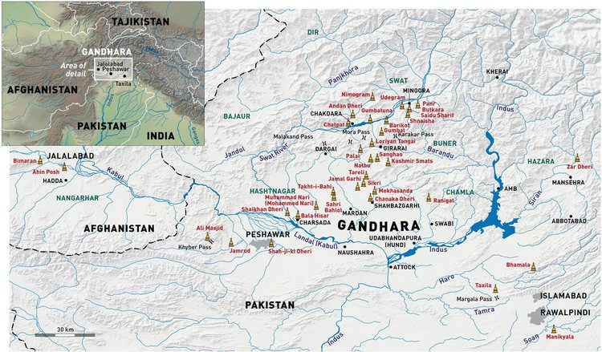

Slide 3
Introduction Gandhara was the name given to the land and its associated civilization that existed in what is now northern Pakistan and Afghanistan from the mid 1st millennium BCE to the beginning of the 2nd millennium CE and consisted of multiple dynasties which ruled over the same area but which were linked by their adoption of Buddhism as a religion for the most part and also of the Indo-Greek artistic tradition as its cultural identity. Although Gandhara has been historically known since the Achaemenian Empire and more specifically during the reign of Cyrus the Great (558-28 BCE), it wasn't until the pilgrimage of XuanXang in the 7th century CE, at the tail end of the Gandhara civilization, that we first see a descriptive account of the region down to the extent of the area itself as well as the various places and sites which can be identified today.

Slide 4
It has been speculated that Ganhara was a triangular tract of land about 100 kilometers east to west and 70 km north to south, lying mainly to the west of the Indus River and bounded on the north by the Hindukush Mountains. (1 li = 500 meters or 1640 feet) The extent of Gandhara proper actually included the Peshawar valley, the hills of Swat, Dir, Buner and Bajaur, all of which lie within the northern bounds of the modern day nation of Pakistan. However the bounds of Greater Gandhara (or regions where the cultural and political hegemony of Gandhara held sway) extended towards the Kabul Valley in Afghanistan and the Potwar plateau in the province of Punjab in Pakistan, in close proximity to the capital city of Islamabad, and bounded off by the location of the grand Mankiyala Stupa on the outskirts of the capital.

Slide 5
Origin of the Name Gandhara The name of Gandhara may have several meanings the most prominent theory relates its name to the word Qand/Gand which means "fragrance" and Har which means 'lands' hence the simplest definition being 'Land of Fragrance'. However, when analyzed critically, the region known as the core of Gandhara around the Peshawar valley does not historically have any historically verifiable association or importance with regards to fragrance, either through flowers, spices, foods etc. Another more probable and geographically supported theory is that the word Qand/Gand is evolved from Kun which means 'well' or 'pool of water' and indeed the word Gand appears with many other place names associated with water i.e. Gand-ao or Gand-ab (pool of water) and also Gand-Dheri (water mound). Tashkand (stone walled pool) and Yarkand are also associated names and hence it holds to reason that the land could have been known as 'Land of the Lake' as this signifies the region between the Indus and Kabul rivers which was a fertile region rich in water supplies and especially around Peshawar.

Slide 6
political History of Gandhara Gandhara witnessed the rule of several major powers of antiquity as listed here: Achaemenids (~600-400 BCE) Greeks (~326-324 BCE), Mauryans (~324-185 BCE), Indo-Greeks (~250-190 BCE), Scythians (~2nd century to 1st century BCE), Parthians (~1st century BC to 1st century CE), Kushans (~1st to 5th century CE), White Huns (~5th century CE) Hindu Shahi (~9th to 10th century CE). This was followed by Muslim conquests by which time we come to the medieval period of Indian History.

Slide 7
Gandharan Art The beginnings of Gandharan artistic tradition can be traced to the 1st century BCE with the waning of the tradition occuring approximately in the 8th century CE and included painting, sculpture, coins, pottery and all the associated elements of an artistic tradition. It really took flight during the Kushan era and especially that of the King Kanishka during the 1st Century CE who deified the Buddha and arguably for the first time introduced the Buddha image which went on to become so prolific as to define the entire Gandharan culture. Thousands of these images were produced and were scattered across every nook and cranny of the region ranging from minute hand held Buddhas to giant monumental statues put in place in the most sacred worship sites.

Slide 8
Indeed it was during Kanishka's time that Buddhism saw its second revival after Asoka. The life story of the Buddha became the staple subject matter for any and all aspects of Gandharan art, and the sheer number of Buddha images ensrhined in chapels, stupas and monasteries continue to be found in great number to this day. The artwork was solely dedicated to the propagation of religious ideals to the extent that even items of everyday use were replete with religious imagery. The focus was on the life story of the Buddha and each piece of sculpture has something to say about the life of this personage. The materials used were either kanjur stone finished with plaster and paint or Schist stone. Kanjur is basically fossilized rock which can be easily molded into shapes which are used as a base for various decorative elements in Gandharan art such as pilasters, Buddha figures, brackets and other elements. After the basic shape has been cut out of stone, this is then plastered with lime plaster to give it a finished look. Gold leaf and precious gems were also applied to select items of great performance and the quality of the artwork varied depending on its use. The maximum size that the schist stone was able to be crafted into was 2.5m square in order to have it be easily transported and hence the larger statues and reliefs are made of clay and stucco.

Slide 9
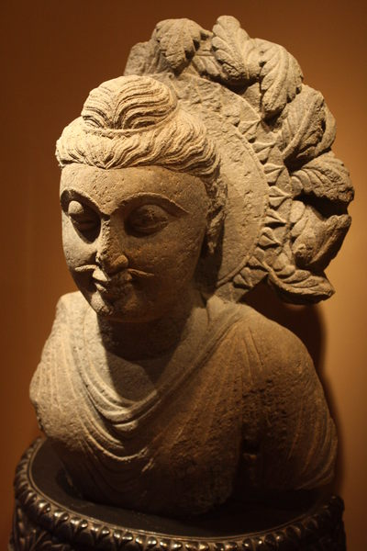
A bust of Buddha from Taxila, Gandhara. Grey-blue schist. 1st century CE. (Museum of Asian Art, Corfu)

Slide 10
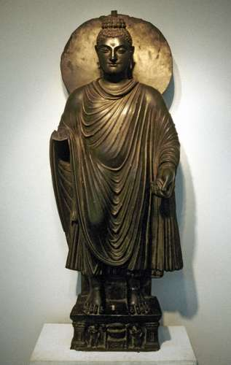
Buddha statue, in the Gandhara style, c. 2nd century; in the Delhi Museum, India.

Slide 11
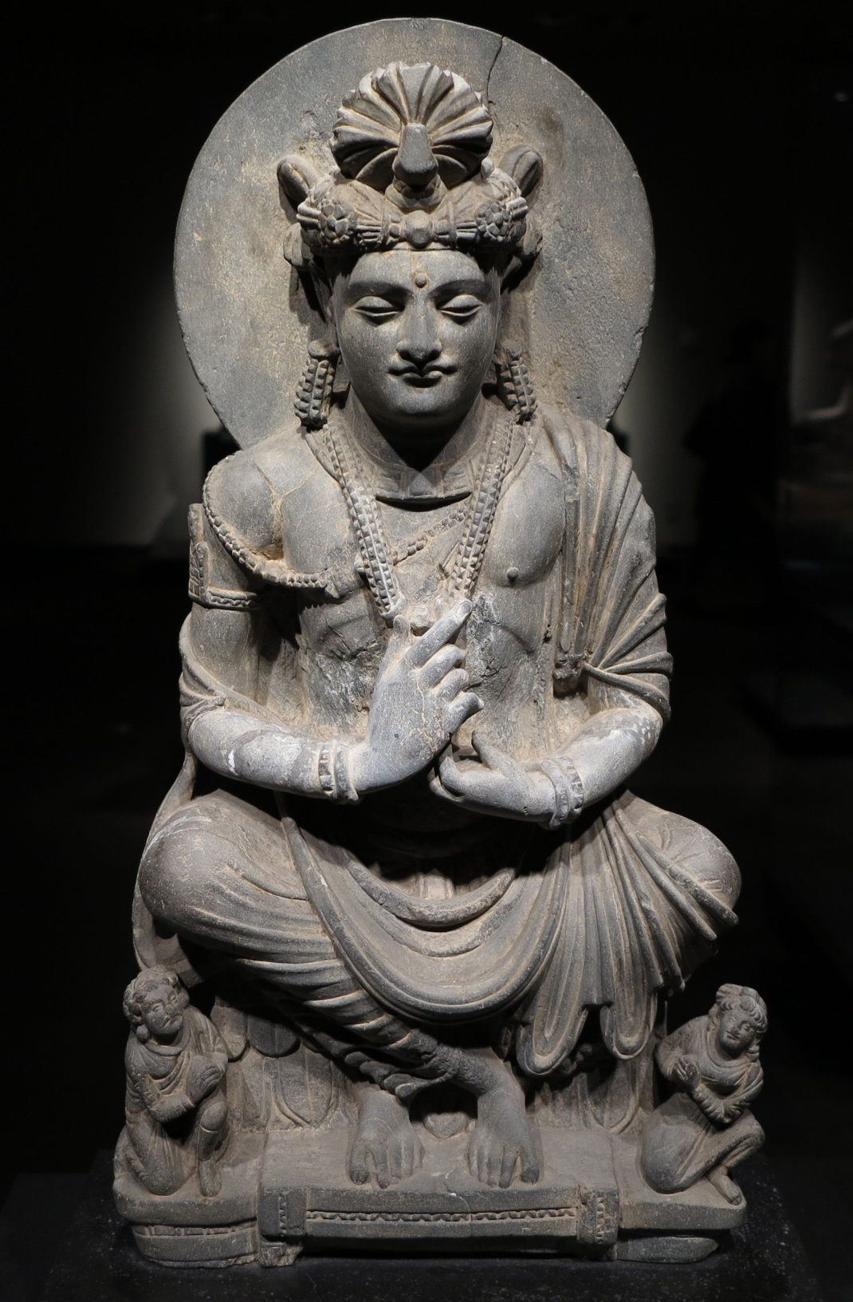

Slide 12
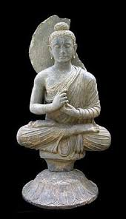

Slide 13
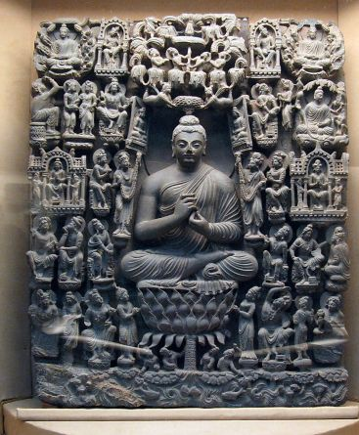

Slide 14
The Buddha was worshipped through these sculptural representations which had a distinct style associated with them that remained largely constant with some changes owing to skill or craft being seen. The Buddha is always depicted in simple monastic robes, with his hair tied in a bun known as the Ushnisha and the expression on his face is almost always one of content. Whereas originally these sculptures were painted in bright colors, now only the plaster or stone remains and barely a handful of items have been found with their original colors intact. Various cult images of the Buddha were made for the varying cults in the region all of which had their own distinct identifying features namely the Laksanas (divine marks), Mudras (hand gestures) and various kinds of robes. . Buddha always had the central role in these pieces and can be immediately identified by the halo and his simple attire. Many mythological figures are also seen as a part of these scenes along with couples, gods, demigods, celestials, princes, queens, male guards, female guards, musicians, royal chaplains, soldiers and also common people. More so, Gandharan art recreates these scenes in such detail that architectural elements and items of everyday use such as beds and vases etc. can be clearly seen in them and also give a glimpse into the building culture of antiquity. Gandharan art can thus provide us with an insight not only one aspect of the ancient life of the region but also of the entirety of the ancient Buddhist daily life.

Slide 15
One of the most enduring elements of Gandharan art besides the Buddha is the Bodhisattva, which is essentially the state of the Buddha before he attained his enlightenment. Multiple Bodhisattvas from the various previous lives of the Buddha are depicted in Gandharan art with Avalokatishvara, Matrya, Padmapani and Manjsuri being prominent. Compared to the austerity of the Buddha images, the Bodhisattva sculptures and images depict a high degree of luxury with many variations on the various elements such as jewelry, headdress, loincloth, sandals and so on and the various incarnations of the Bodhisattva are recognisable from their clothing and postures, mostly of the hands in the seven mudras.

Slide 16
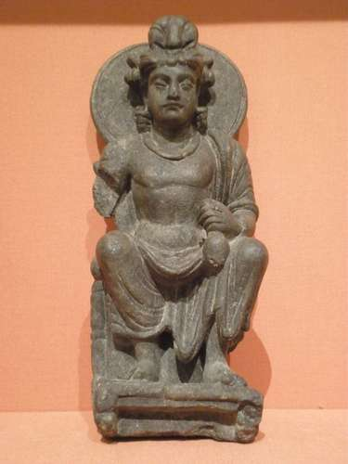
Bodhisattva Maitreya, schist sculpture from Gandhara, Pakistan, Kushan dynasty, 2nd–3rd century; in the Victoria and Albert Museum, London.

Slide 17
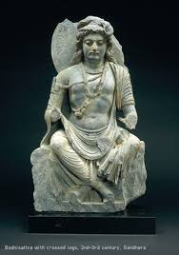
Bodhisattva

Slide 18
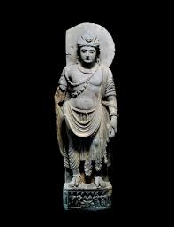
Bodhisattva

Slide 19
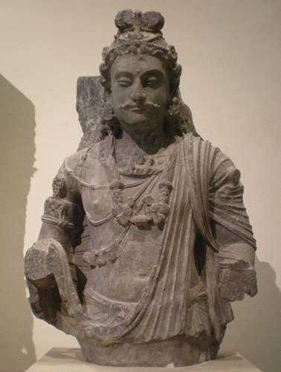
Maitreya Bodhisattva Maitreya, schist from Gandhara, Pakistan, Kushan dynasty, 2nd–4th century CE; in the Victoria and Albert Museum, London.

Slide 20
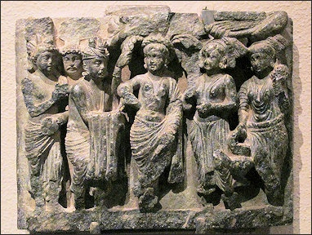

Slide 21
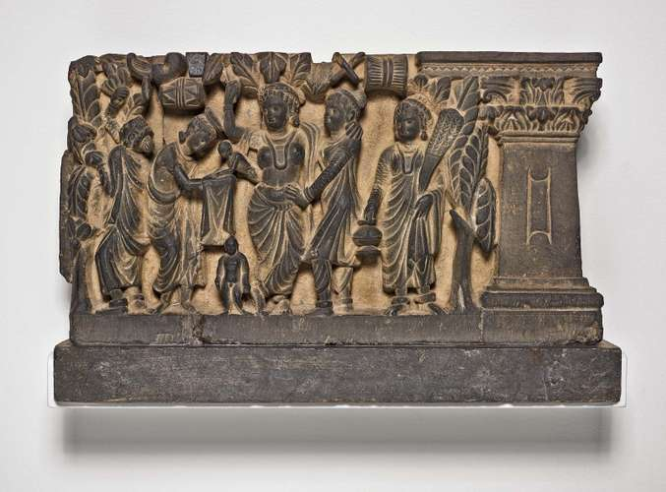
The Birth and the First Seven Steps of the Buddha, gray schist relief, Gandhara, 2nd or 3rd century CE; in the Art Institute of Chicago.

Slide 22
Gandharan Architecture Much can be said about the architectural tradition of Gandhara but the most prominent and unique characteristic of it was the proliferation of stupas and other associated religious establishments such as monasteries which formed the core of the regional identity for nearly 1000 years. The Stupas were built mainly for the reverence of the remains of Buddhist masters and the most important ones held the remains of the Buddha himself. Besides the Buddha, monks of high stature were also venerated by having stupas built for them and these edifices also marked the places where certain legendary events related to the various lives of the Buddha were said to have occured. The proliferation of stupas across India is said to have been the hallmark of Asoka's rule who reinterred the ashes of the Buddha in multiple stupas all across his kingdom. Even though it was mainly an architectural feat, the stupa nonetheless was a vessel for the display and worship of the prolific Gandharan art, encompassing sculptures, reliefs, paintings and other highly decorated elements that encased the structure and added immensely to not just its beauty but its veneration as a religious site. These images stood against walls, in courts, inside niches and chapels and stuccos adorned the walls of the stupa courts and monasteries.

Slide 23
Stupas were initially built with circular bases and were of modest size, but as the cult of the Buddha grew in importance in the region, these centers of worship were elaborately designed and adorned to boost the stature of the religion and to attract more worshippers. The original stupas at Kunala and Dharmarajika were small affairs which were later on expanded to grand proportions by rulers such as Asoka and Kanishka. A base (medhi), either circular or square, would support a drum or cylinder on top of which the dome (anda) would be placed. Steps were used to surmount the platform and to begin the clockwise circumbobulation around the dome along the processional path (Pradakshina Patha) which was bounded by the railing (vedika). At times the base would have multiple circular stories raising the height of the stupa. The corners of the base were usually affixed with lion capital pillars and the top of the dome had first a harmika, an inverted square enclosure on which stood the yasti or pillar which had the various chattras or parasols diminishing sizes equally distributed along it.

Slide 24
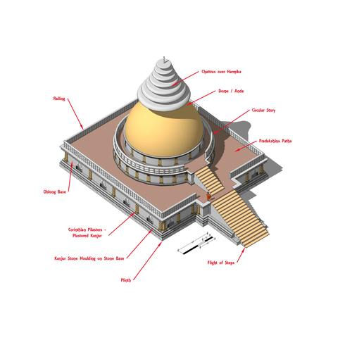
An isometric image of Badalpur stupa showing the various elements which make up a stupa. Dated to 2nd - 5th Cent CE

Slide 25
The Stupas came to represent the zenith of buddhist architectural achievement in the region and of course, as with the artwork, they are also meant solely to promote the religious power structures. The Stupas themselves were decorated with uncountable relief panels and friezes depicting religious stories and events further solidifying their role. The Stupa was the main center of worship and in support it had the monastery, a structure with its own fully contained living area for monks. The monastery or Sangharama became a huge part of the Buddhist tradition and over time came to be its own self-sustaining unit, with lands for growing crops and wealth showered on them by lay people and royalty alike for their blessings.

